Slide 1
The Forgotten War: The ongoing conflict in Sudan, largely ignored by the International Community
THE FORGOTTEN WAR
An ongoing conflict in Sudan largely ignored by the International Community
By
Faisal Abdalla Sinada B Sc, M Sc, Ph D, FLS
Department of Botany, Faculty of Science,
University of Khartoum, Sudan
“Twenty years ago, Darfur was the world’s largest
hunger crisis
and the world rallied to respond.
But today, the people of Sudan have been forgotten.
Millions of lives and the peace and stability of
an entire region are at stake,”
said Cindy McCain, Executive Director of the WFP.
Khartoum, March 2024

Slide 2
Sudan is in north-east Africa;one of the largest countries on the continent Sudan 7 neighbours pay a price as refugees pour into their countries

Slide 3
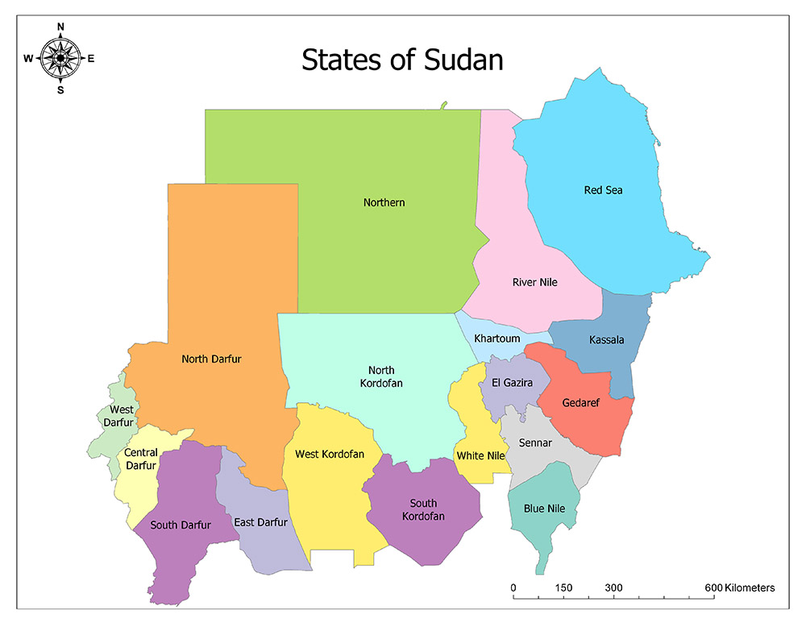

Slide 4
2a Introduction to the Conflict
Hostilities erupted in mid-April 2023 between General Alburhan (SAF) and General Daglo (RSF).
Each side accuses the other of firing the first shot.
Power-sharing history between the two leaders.
The two staged a coup d'état in October 2021, overthrew the civilian government of Prime minister Hamdok but failed to appoint a new government .
The two generals recently openly sided with opposing factions and got involved in a power struggle.
General Alburhan with militant Islamists who want to return to power and General Daglo with pro- democracy supporters of the December revolution.

Slide 5
2b
The paramilitary RSF was established in 2013.
The militia group was then utilized by Islamist regime to fight anti-government rebel groups in Darfur, South Kordofan and Blue Nile States.
The current conflict started in Khartoum State tri-city capital and Darfur, later spreading to other states.
Fear of further escalation to safer areas.

Slide 6
Abdel Fattah al-Burhan, the Supreme Commander of the Sudanese Armed Forces (SAF), and his rival, Mohamed Hamdan Daglo, Commander of the paramilitary Rapid Support Forces (RSF).

Slide 7
3 International efforts to stop the war
External mediation attempts over 10 months.
Treaty of Jeddah (2023) ineffective, leading to accusations and arguments.
Paramilitary RSF and SAF accused each other of atrocities against civilians.
IGAD mediation efforts failed in December 2023.
On 8/3/2024 UN Security Council voted urging parties to stop fighting during the holy month of Ramadan. The Army rejected the resolution.

Slide 8
4 Devastating impacts of the war (Statistics)
Largest internal displacement crisis globally-more than Syria
Urgent humanitarian aid needed for ~25 million people in several states.
Insufficient humanitarian aid received.
UN's Humanitarian Response Plan received 33% of $2.6bn Rising crises: Famine warning, hunger, cholera outbreak.
UN estimates13,000 + civilians killed, 33,000 injured, 9 million internally displaced, 1.5 million refugees, 19 million children without education, 3.8 million malnourished.
In Zamzam camp in Darfur: A child dies every two hours.
Wide-scale atrocities: massacres, sexual violence, looting.

Slide 9
Refugee Camp in Chad near the border

Slide 10
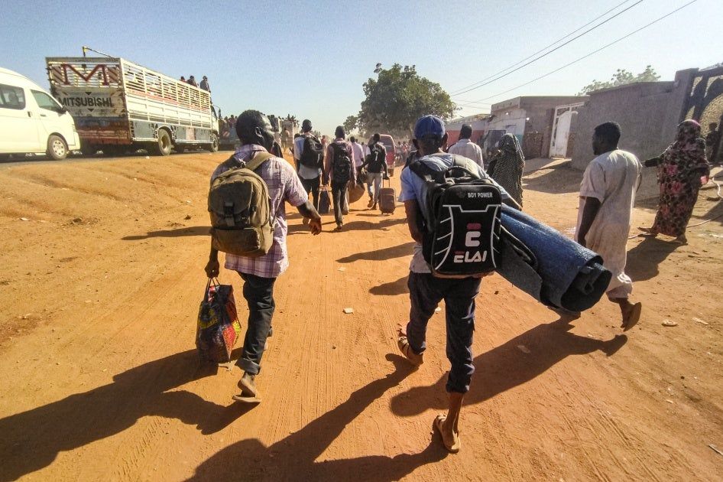
People displaced by conflict flee with their belongings out of Wad Madani, the capital of Gazira State, when it came under attack by the Rapid Support Forces (RSF) December 2023

Slide 11
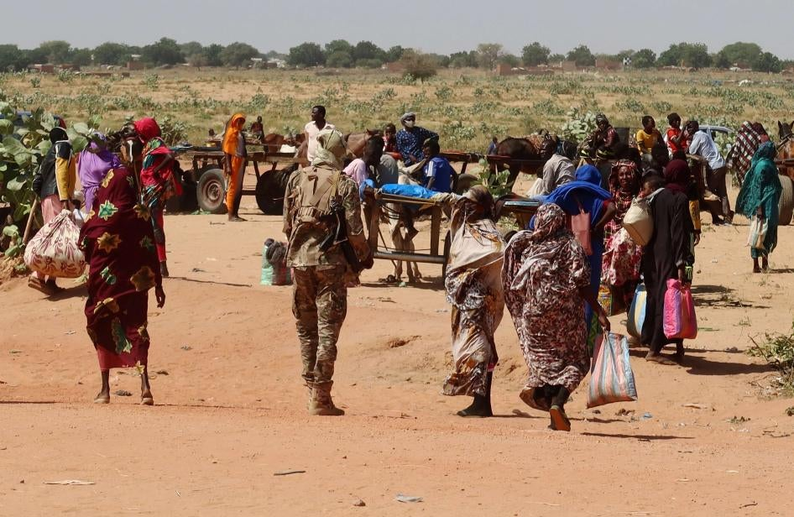
Families escaping Ardamata in West Darfur cross into Chad, after a wave of ethnic violence, November 2023. Survivors recounted executions and looting in Ardamata, which they said were carried out by RSF and allied Arab militias.

Slide 12
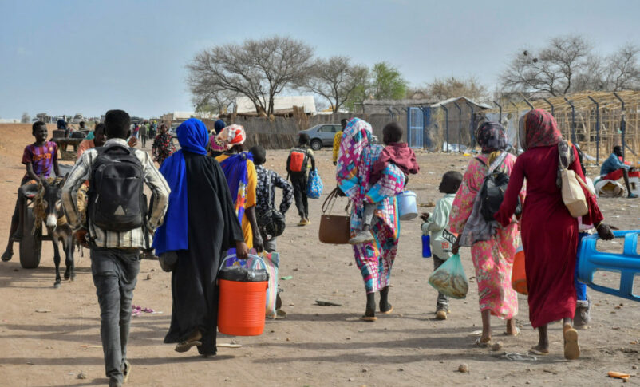
Civilians fled Sudan walking to South Sudan April 2023

Slide 13
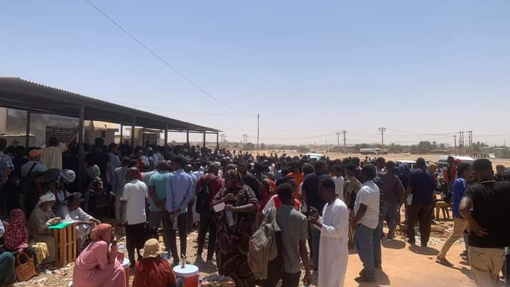
Sudanese crowding in front of the Egyptian consulate in Wadi Halfa at Sudan-Egypt border, waiting to obtain a visa

Slide 14
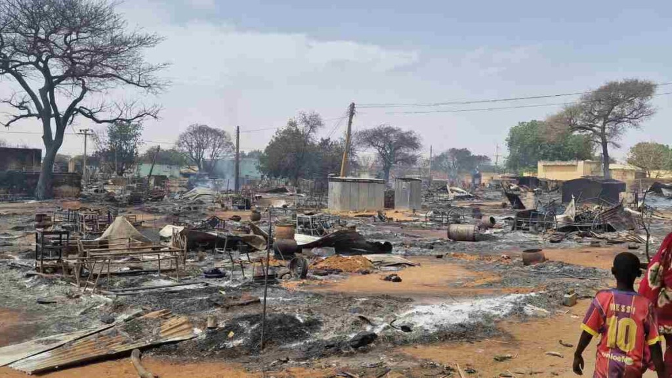
The remains of a camp for internaly displaced people near El Geneina capital of west Darfur after attacks by Arab militi in mid-May 2023

Slide 15
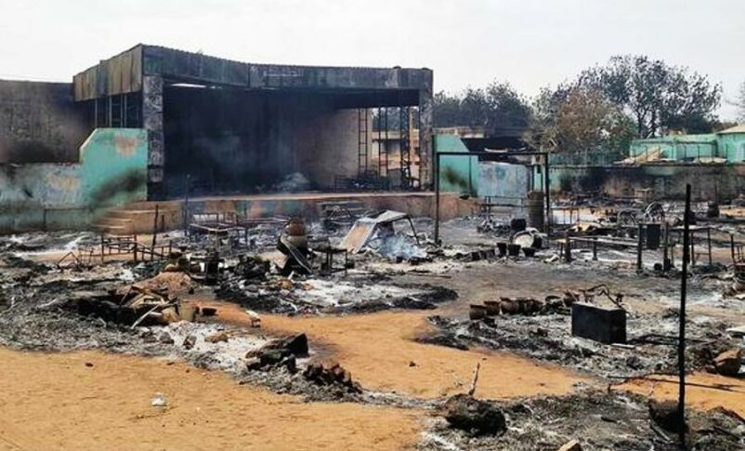
IDP camp in Elgineina ravaged by Arab militias prompted thousands of people to flee to Chad for safetyearly une 2023

Slide 16
Chad: An aerial view of refugee camp of Sudanese people who fled the conflict in Geneina in Darfur region, in July 2023

Slide 17
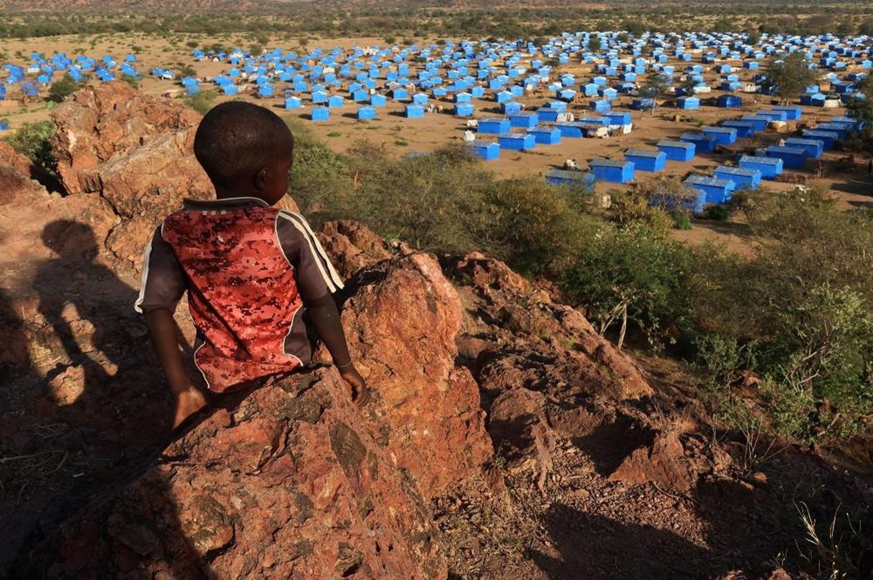
A hill overlooking a refugee camp near the Chad-Sudan border, November 2023

Slide 18
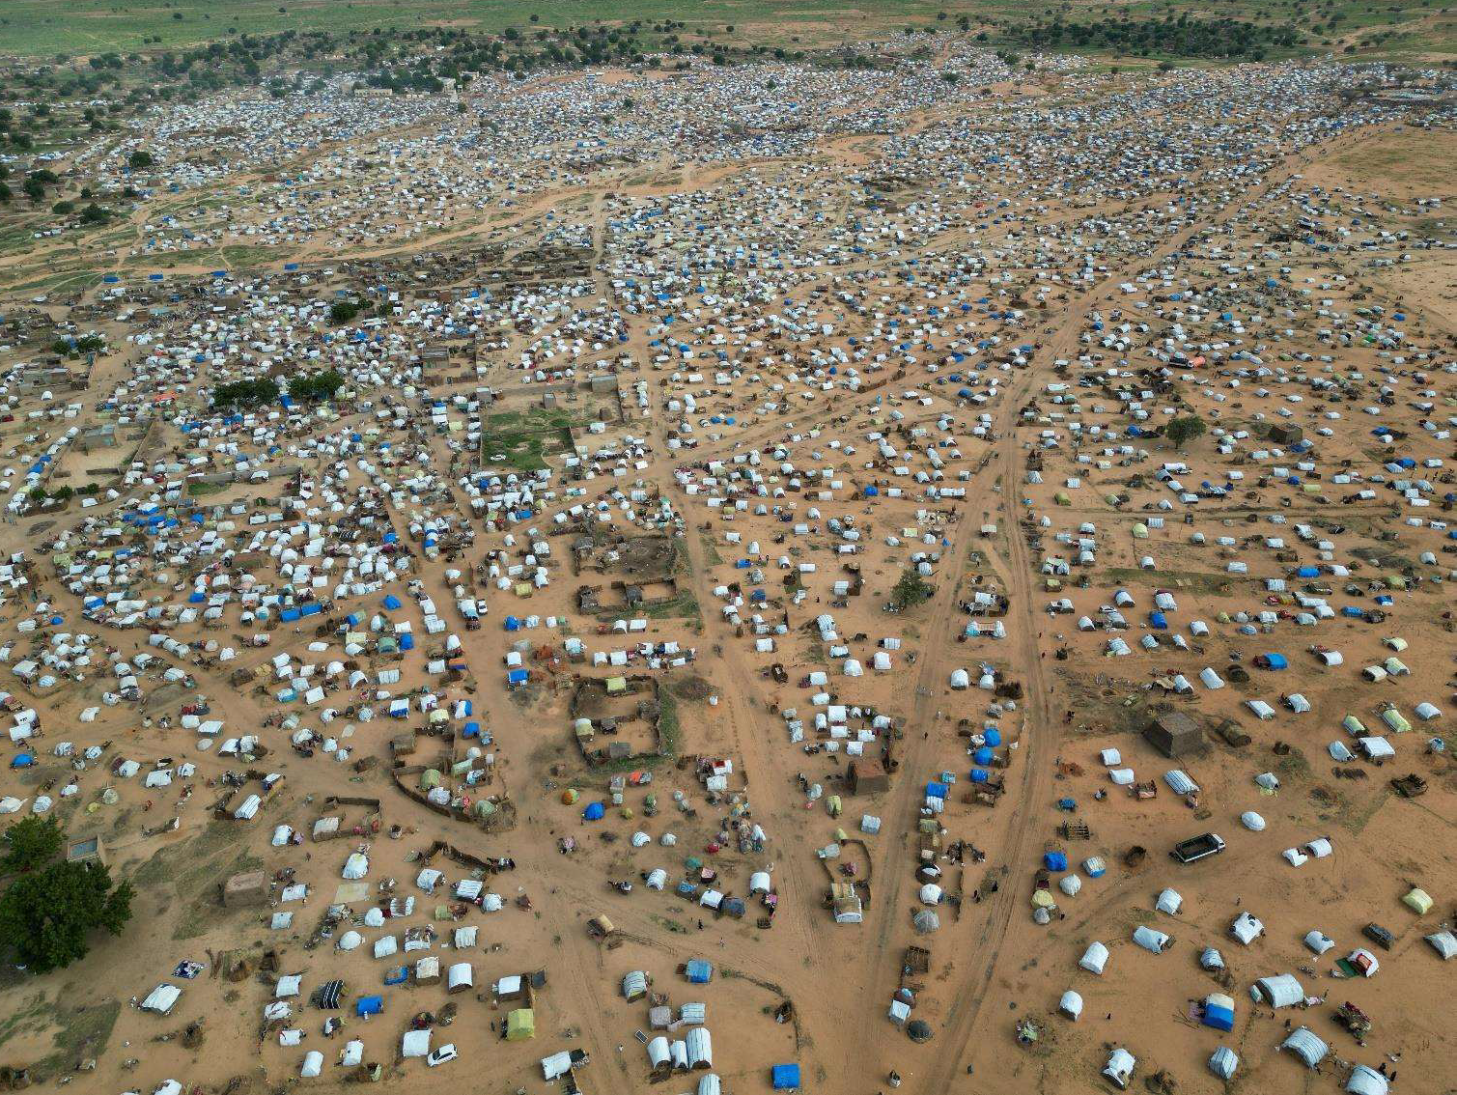
An aerial view of refugee camp for Sudanese who fled the conflict in Sudan's Darfur region, in Adre, Chad July 2023

Slide 19
Horrifying impacts of the war (continued)
5
Destruction of infrastructure and deliberate attacks on civilians.
Looting, killings, and demographic displacements in Khartoum.
80% of hospitals in conflict areas non-functional.
> 158 major markets in the capital were subjected to aerial bombardment
Deserted marketplaces were destroyed and looted.
Open air markets were established for looted items outside Khartoum and in Darfur.
Deaths in Khartoum attributed to starvation have been reported.
Calls for safe aid delivery and humanitarian access are unanswered.

Slide 20
Pillage and looting
In January 2024, the Sudanese Observatory for Human Rights reported that since the war began in April 2023, the RSF forces and criminals have plundered more than a million residences in Khartoum, the capital city.
This amounts to more than half of all households in the State.
Such widespread pillaging and looting on this magnitude has not been witnessed globally in over a century.

Slide 21
Photos
Mass looting of shops and markets
(Khartoum tri-city capital markets)

Slide 22
The unprecedented mass looting of Khartoum’s shops and markets.. Shattered facades

Slide 23
The mass looting of Khartoum’s shops and markets: High Street..Shattered facades

Slide 24
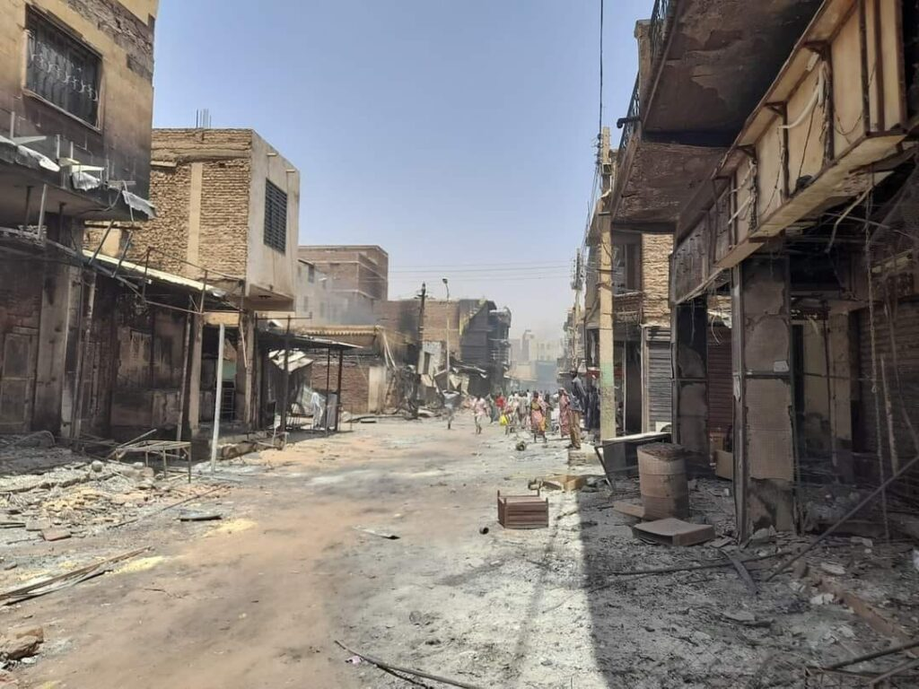
The mass looting of shops and old markets in Khartoum State

Slide 25
Shattered facades and broken locks... looted Khartoum market

Slide 26
Photos
Open-air bazaars and markets of stolen items
(Along the high way between
Khartoum and Wad Madani City)
Stolen cars were driven to Darfur

Slide 27
• Open-air bazaars were established on the main road linking Khartoum to Wad Madani city (180 km) offering looted items

Slide 28
Open-air bazaar exhibiting brand new looted items

Slide 29
Open-air bazaar exhibiting brand new looted items

Slide 30
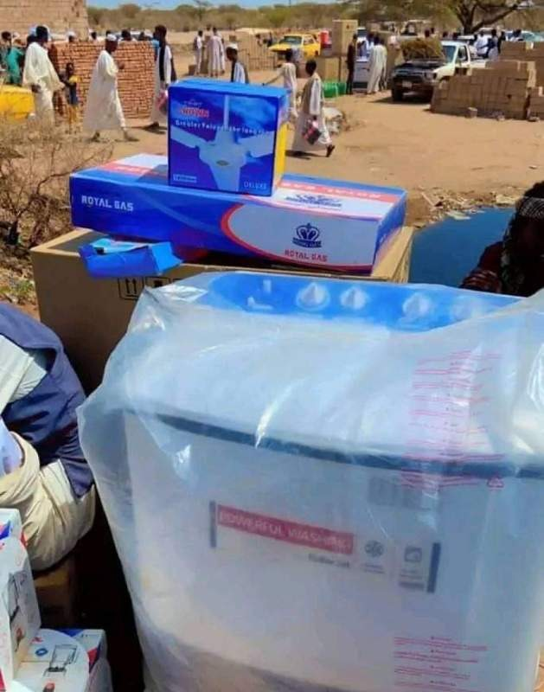
Open-air bazaar exhibiting brand new looted items

Slide 31
6 Reasons for Conflict
Primariliy struggle for power backed by foreign entities.
External agendas aimed at destabilizing Sudan.
Extremist Islamic group controlling the army seek to prolong the conflict.
This group continues to persist in eliminating pro-democracy civilian rivals and reclaiming lost power.

Slide 32
7 Effect of War in Khartoum capital
Food insecurity
Famine crises : Sudanese in Khartoum and Darfur states go hungry as war disrupts food supply in rain fed and irrigated farms and due to mass unemployment and loss of income.
Latest update World Food Program reported 18 million people across Sudan currently face acute hunger.
The U.N. food agency received reports last month of people dying from starvation in Sudan.
Energy crisis from oil refinery shelling.
Power outage: no electricity.163 km of connection wires and more than 9000 electricity poles were destroyed.
Water scarcity damage of 6 purification plants.
Psychological health impact leading to psychological disorders.

Slide 33
Photos
Food insecurity
(Khartoum and Darfur)

Slide 34
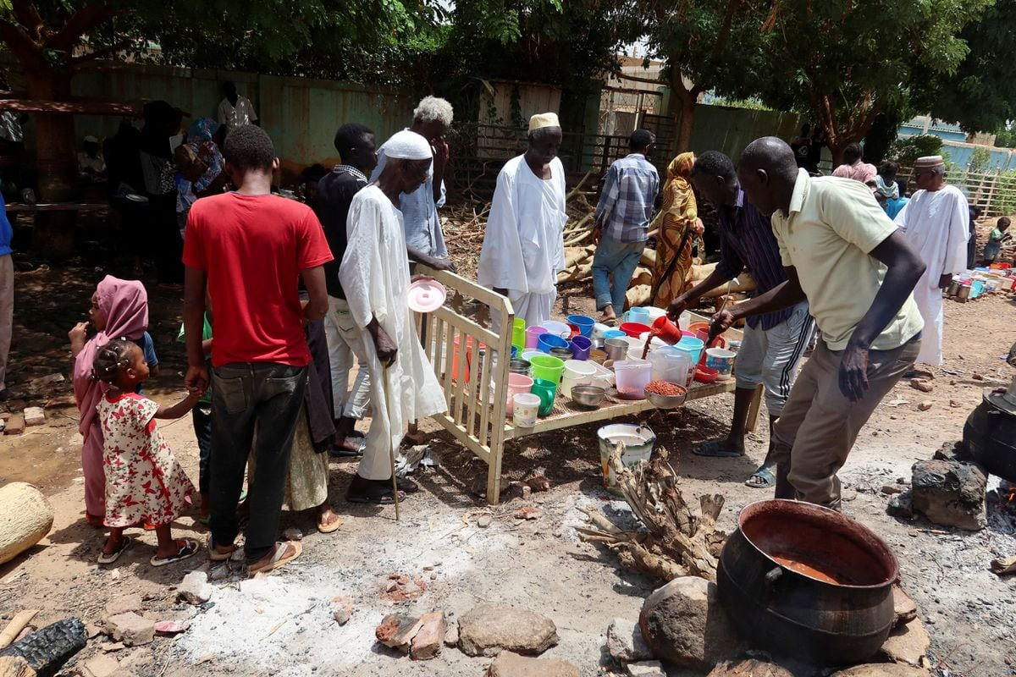
Food insecurity:People wait for food distribution organized by volunteers in Omdurman (one of 300 community kitchens in Khartoum tri-city capital) September 2023

Slide 35
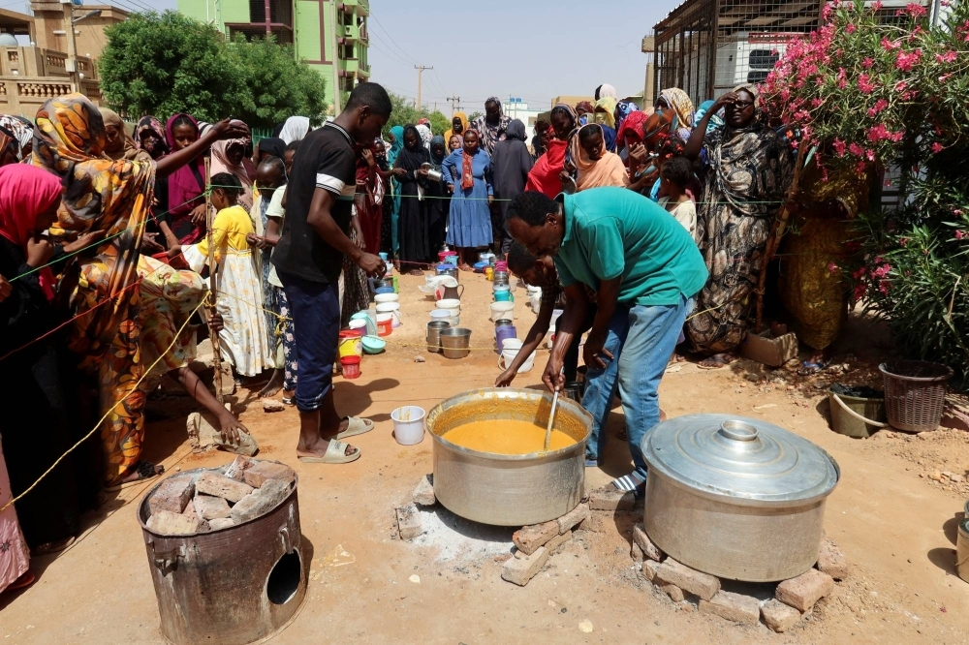
Food insecurity:People wait for food distribution organized by volunteers in Omdurman (one of 300 community kitchens in Khartoum tri-city capital)

Slide 36
volunteers in one of 300 community kitchens in tri-city capital Khartoum preparing food for distribution

Slide 37
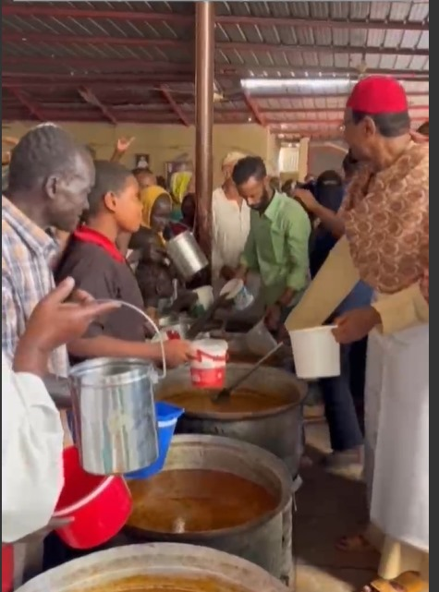
Sheikh El Amin, a sufi leader in his charity kitchen annexed to his mosque in Omdurman

Slide 38
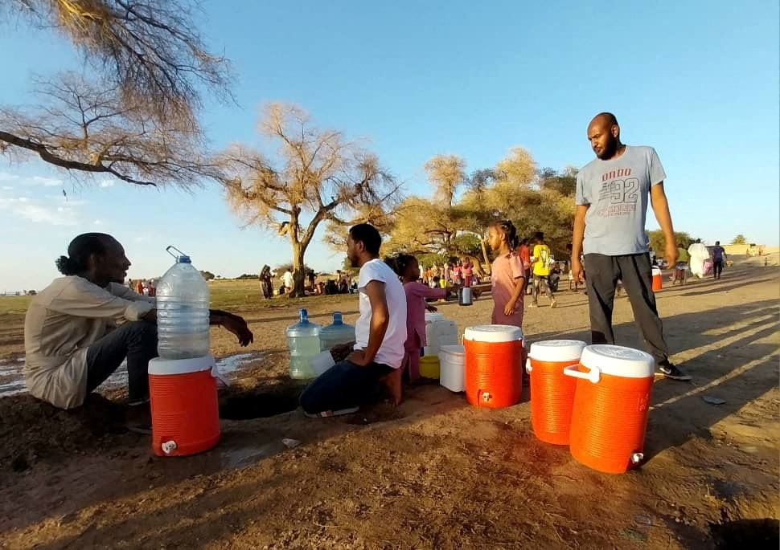
Citizens dig small holes at the shore to get pure water at the banks of the White Nile as clashes between the Paramilitary Rapid Support Forces and the Sudanese army continue, in Khartoum, Sudan, May 2023, ten months ago (3 weeks after the start of war)

Slide 39
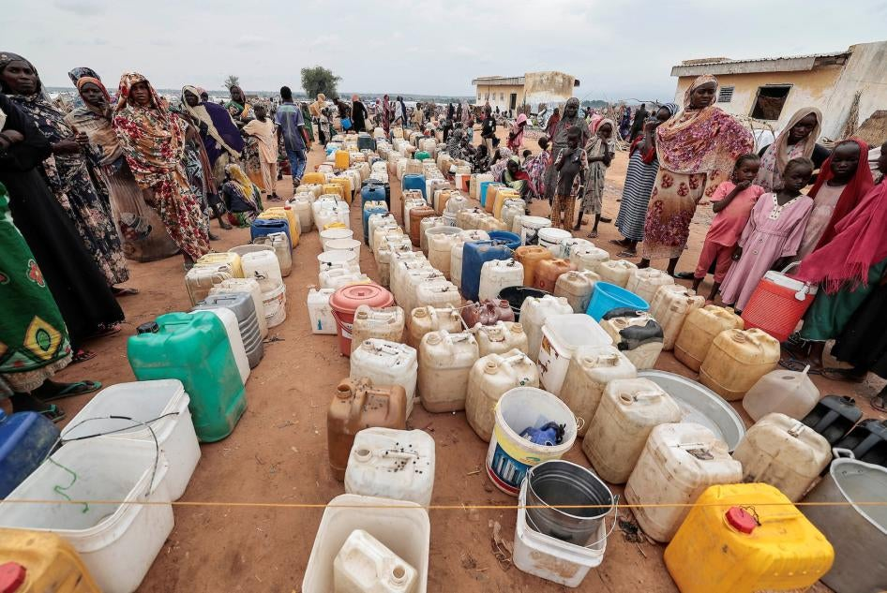
Sudanese women and children who fled the conflict in Geneina, in Darfur region, line up at the water point in Adre, Chad, July 30, 2023. © 2023 Reuters

Slide 40
8 Consequences of War
Wide-spread unemployment and loss of income.
General mobilization among youth by Sudan Armed Forces (SAF) contribute to spread of weapon.
Spread of weapons in previously safe areas threatens to renew tribal conflicts.
Recruitment by Rapid Support Forces(RSF) from Darfur areas.
Spread of hate speach intensifies political and societal divisions.

Slide 41
9 Losses during the initial 11 months of conflict
Unprecedented violence causing deaths, sexual violence, looting, and destruction.
>13,900 fatalities from aerial bombardment and ground clashes.
Wide-scale infrastructure destruction in Khartoum.
> 6 million Khartoum residents displaced.
Latest update >10.7 million people have been displaced, according to the U.N. migration agency.
Sudanese currency lost 90% of its value.
Bank closures affect import-export activities.
>4 million government and private sector employees in Khartoum lost their jobs and income.

Slide 42
10 Populations and Areas Affected by Fighting
Khartoum State, inhabited by ~7,700,000 (2017)
Darfur 5 States, inhabited by ~ 9,500,000 (2017)
Gezira State, inhabited by ~ 5,000,000 (2017)
The most affected was Khartoum’s tri-city capital where government buildings, hospitals, schools, universities, marketplaces, the airport, one of the bridges across the Nile, water treatment plants, power stations, the oil refinery, petroleum oil storage tanks and thousands of citizens’ homes were destroyed.

Slide 43
Scenes of Mass Destruction
(Khartoum and Darfur)

Slide 44
Doctors’ Hospital (a private hospital in Khartoum)

Slide 45
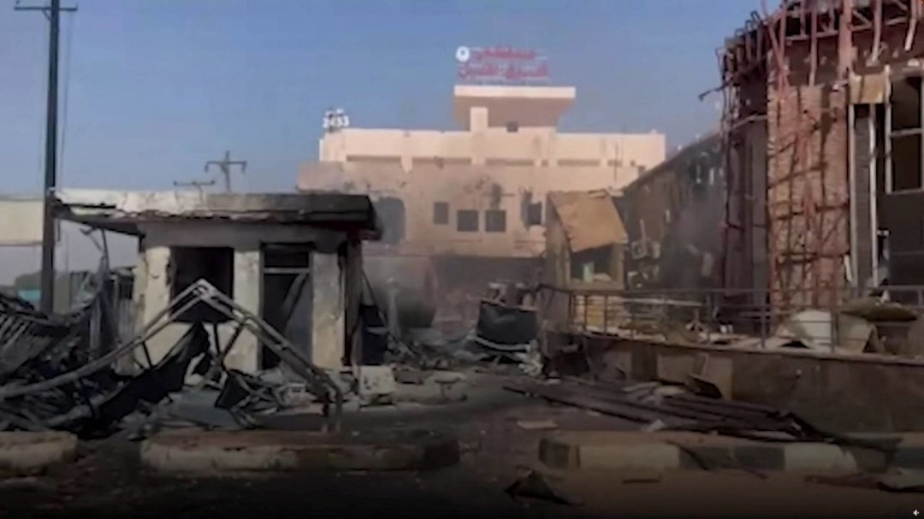
East Nile Hospital in Khartoum was destroyed in an air strike

Slide 46
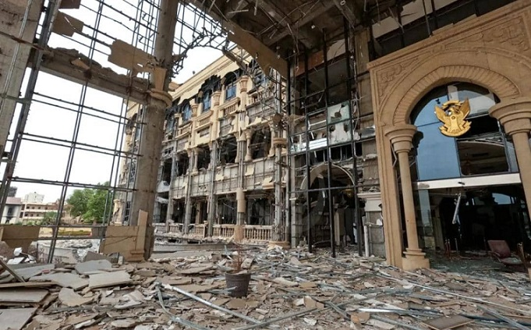
Presidential Palace Khartoum One of 33 archaeological and historical monuments destroyed in Khartoum. It was built in Khartoum during Turkish rule

Slide 47
Sudan war: At least 13,900 killed, several thousands injured and homes destroyed in ongoing Khartoum shelling

Slide 48
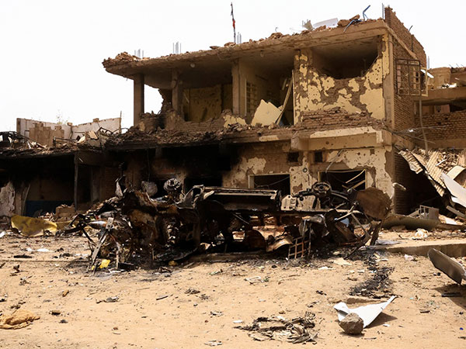
Central market KhartoumNorth May 2023

Slide 49
Fasher the capital of Darfur: Market on fire

Slide 50
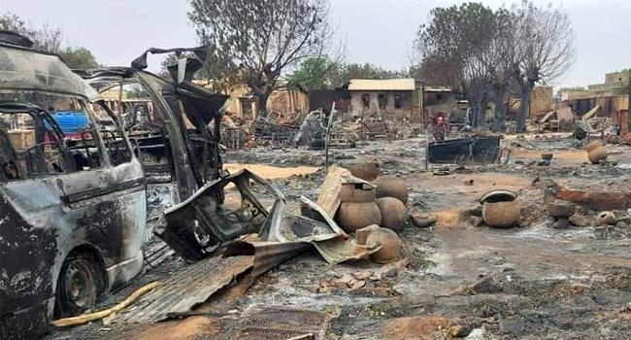
Livestock market area in Fasher, the capital of Darfur Region September 2023

Slide 51
Central Khartoum in flames

Slide 52
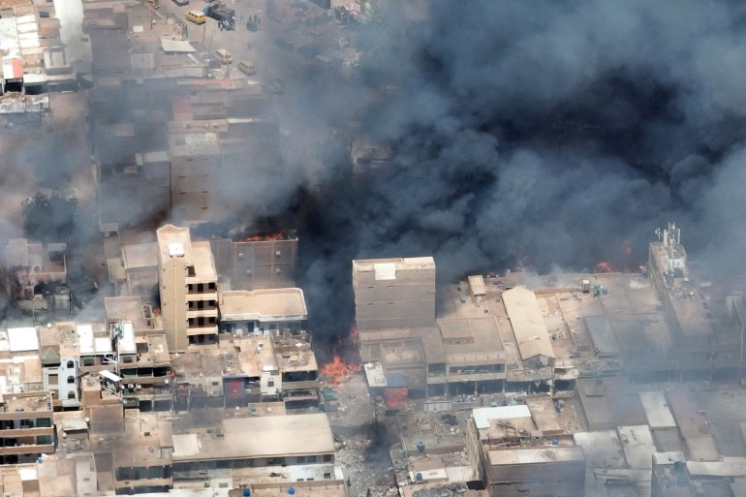
Nyala capital of South Darfur State

Slide 53
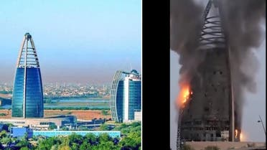
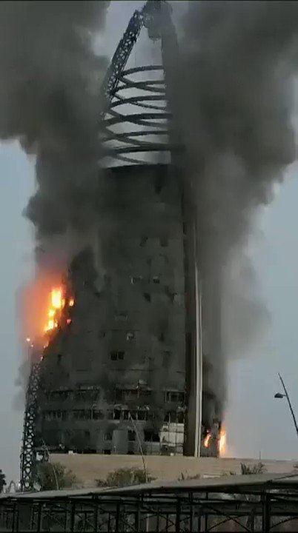
Khartoum the Capital of Sudan

Slide 54
Many Khartoum homes and businesses have been destroyed by artillery fire

Slide 55
Khartoum May 2023

Slide 56
Khartoum April 2023

Slide 57
Khartoum Airport

Slide 58
Khartoum Airport

Slide 59
Impact on Education (Schools and Universities) 11
Sudan is facing a severe education crisis according to U.N. with irreversible damage.
> 10,400 schools have closed indefinitely due to conflict.
>19 million pupils and students affected by closures.
~7 million children already out of school before the conflict.
~5.5 million children in safe areas are awaiting decision from local authorities on date of reopening schools.
However, schools in safer states have been turned into emergency shelters for displaced people or as barracks.
No official knows when schools reopen.

Slide 60
Schools in safer states have been turned into emergency shelters for displaced people

Slide 61
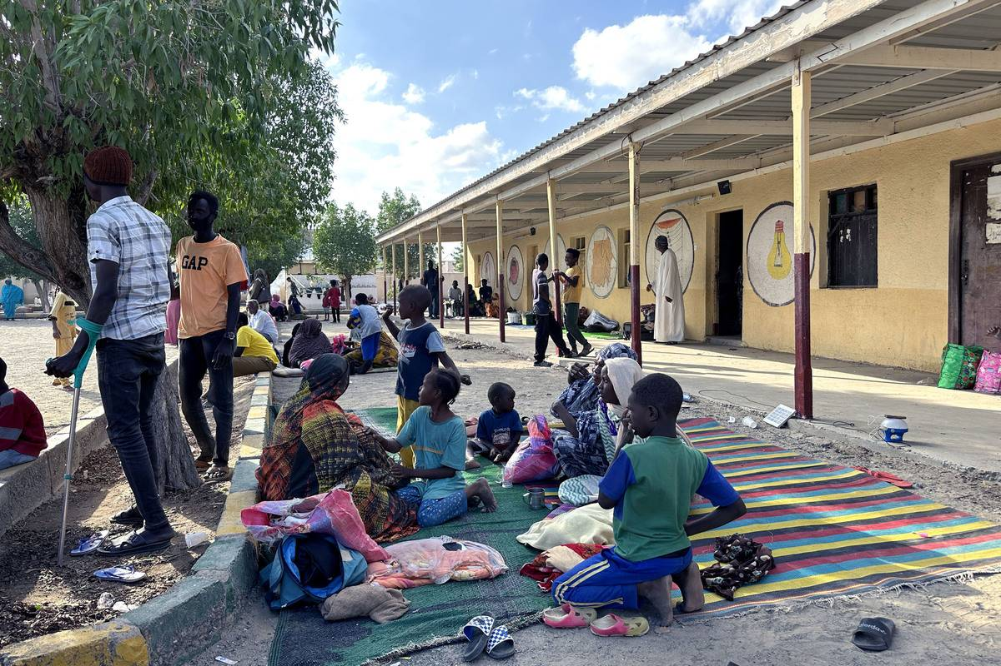
Displaced citizens take shelter in a school building in the new capital Port Sudan, January 2024

Slide 62
12 Educational Institutions
Several government and private universities in Khartoum State were subjected to :-
intentional destruction,
widespread looting by thieves and criminals,
university buildings, libraries, laboratories and documents and academic files were destroyed by fires;
leaving nothing but walls.
These include : Al Mughtaribeen University
Mashreq University
Nahda College
Ahfad University for Women.
Students fled conflict areas with their families

Slide 63
Many students encounter a significant challenge in obtaining documentation to verify their enrollment at their respective universities.
Universities lost faculty members who escaped the war to work in universities and research institutions abroad.
Severe infrastructure damage makes restoration challenging.

Slide 64
The intentional burning of the Omdurman Ahlia University library resulted in a fire that lasted for three days

Slide 65
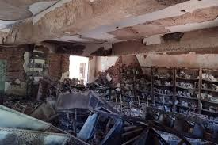
Sudan’s rare books and historical documents resided in Ahlia University library in Omdurman one of the tri-city capital.

Slide 66
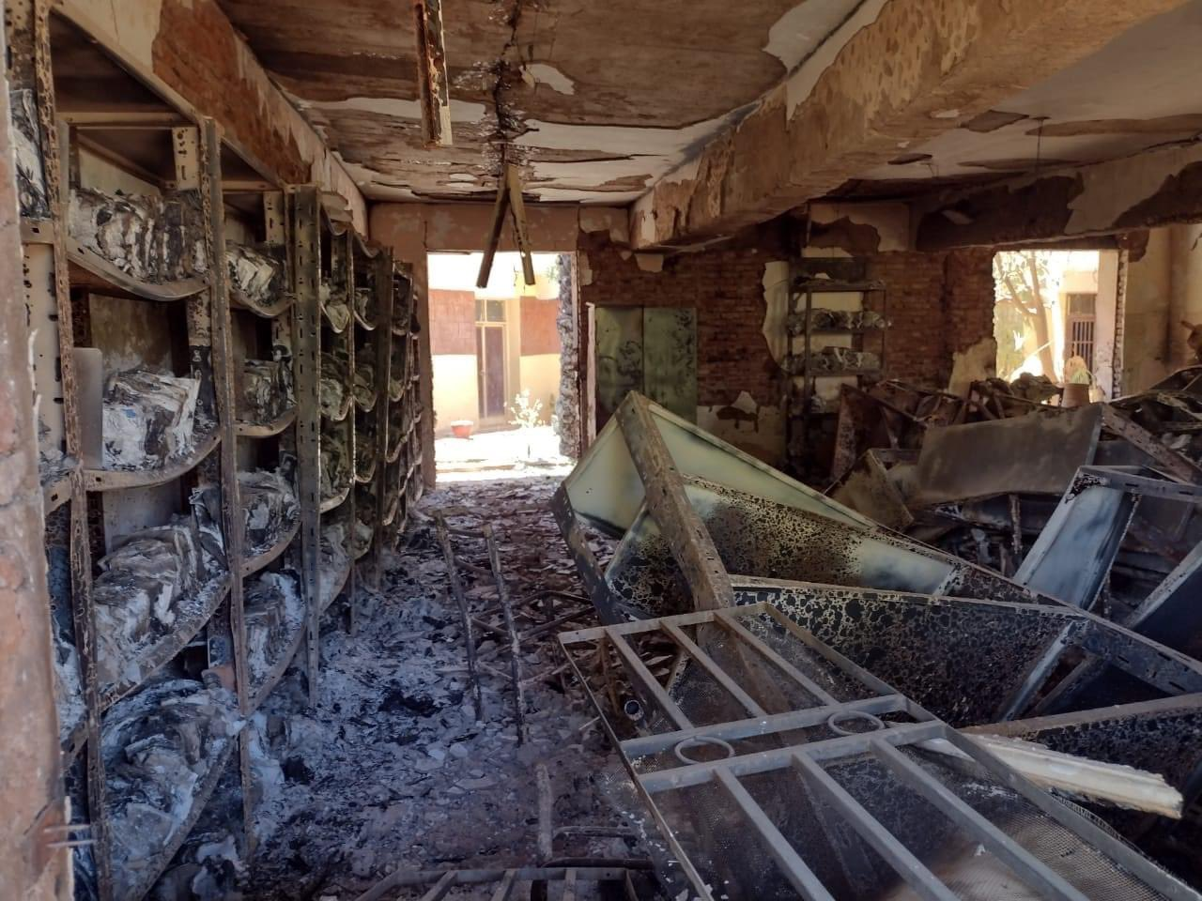
Omdurman Ahlia University library in ashes

Slide 67
Fire destroyed Mashreq University in Khartoum May 2023

Slide 68
13 Studying Abroad as an Option as an Option
After the outbreak of the war many families evacuated to safer locations.
University students sought refuge abroad with their families and some of them join foreign universities.
University of Medical Sciences and Technology (UMST) a private university relocated to Rwanda and Tanzania.
Affluent students transferred to UMST in Rwanda and Tanzania and other foreign universities abroad.
Studying abroad impacts Sudanese universities and the country's future.

Slide 69
14 Challenges Facing Higher Education
Previously higher education disruptions due to various reasons like the December 2018 revolution and the COVID-19 pandemic and teachers’ strike.
University studies suspended in remote conflict zones due to “old wars” and teachers’ strikes.
Accumulation of academic batches already poses challenges for universities.
Few universities have made arrangements to examine their final year students in Sudan and abroad.
All universities are yet to start the new academic year. When? Nobody has an answer.

Slide 70
Post-War Era: Successful Reconstruction Process
15
Reconstruction after the war ends will be challenging.
Countries emerging from civil wars (eg Syria, Libya, Yemen)still waiting for external financing for reconstruction
Sudan is reliant on external financing for reconstruction.
Need for a novel political process for long-term stability and funding.
Displaced students facing instability and economic hardships.
Numerous students already shaped their future, and forced to take up part-time jobs to support their families due to the harsh economic conditions arising from the conflict.

Slide 71
16 Conclusion
Gloomy future. It shall be a very long time before pre-war normal life is reconstructed, let alone a better life.
Until then students remaining within Sudan will be away from universities and schools for a long time.
Universities in Khartoum face decades of rehabilitation challenges.
Pre-war infrastructure deficiencies worsen rebuilding difficulties.
Restoration of universities may take decades to achieve.

Slide 72
Let us hope for the best
Thank you for your listening

Slide 74
Sudan is in north-east Africa;one of the largest countries on the continent Sudan 7 neighbours pay a price as refugees pour into their countries

Slide 75
CNN —
Thousands of people have been killed and nine million displaced since fighting broke out in April 2023 between forces loyal to two rival generals – army chief Abdel Fattah al-Burhan, who leads Sudan’s Armed Forces (SAF), and the head of the paramilitary Rapid Support Forces (RSF) General Mohamed Hamdan Dagalo.
The war in Sudan is “triggering the world’s largest hunger crisis,” with more than 25 million people “trapped in a spiral” of food insecurity, a United Nations agency has warned.
Nine in 10 people across the country face “emergency levels of hunger” and are “stuck” in areas “largely inaccessible” due to “relentless violence and interference by the warring parties,” said UN’s World Food Program (WFP).
“Twenty years ago, Darfur was the world’s largest hunger crisis, and the world rallied to respond. But today, the people of Sudan have been forgotten. Millions of lives and the peace and stability of an entire region are at stake,” said Executive Director of the WFP.

